Slide 1
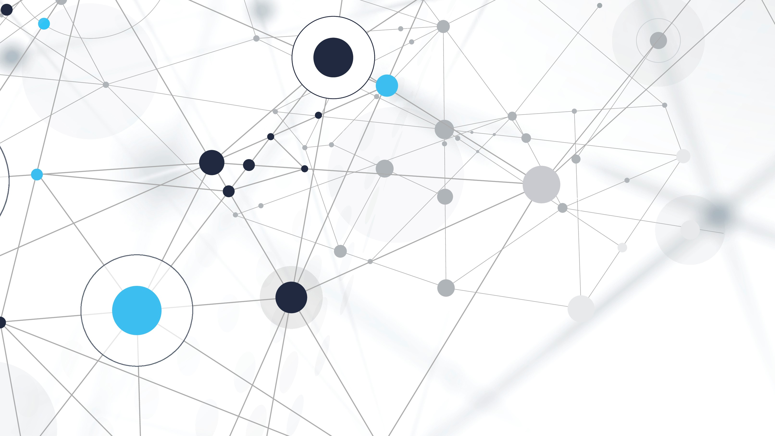
Learning to Kern: Comparison of Architectures for Optimal Letter Space
Angelantonio Fedele Murolo

Slide 2
What is kerning?
- Horizontal space between adjacent letters in a font
- Optical, not mechanical
- Decided by designers pair by pair - or by heuristics
One font ⇒ 52 × 52 = 2,704 spacings to set

Slide 3
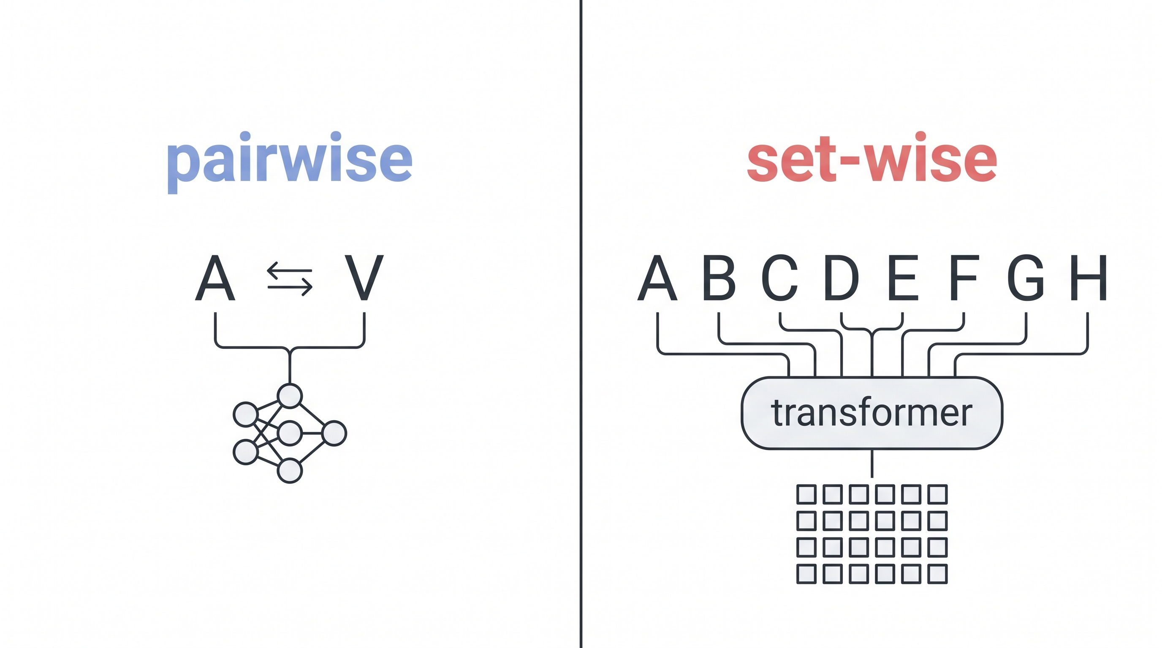
Two models
- Two letters at a time
- No global context
- All N² spaces estimated jointly
- Whole alphabet given at once

Slide 4
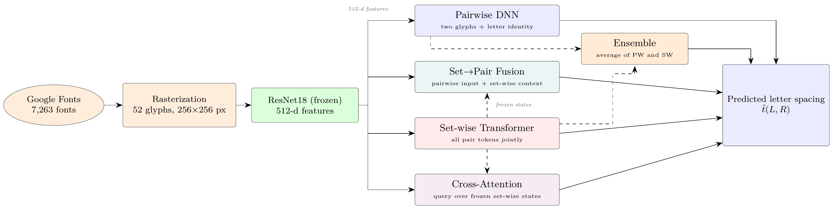
THE Pipeline

Slide 5
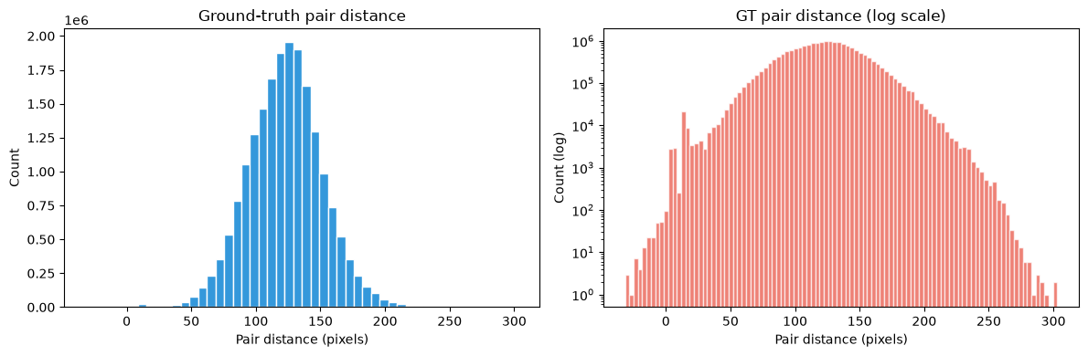
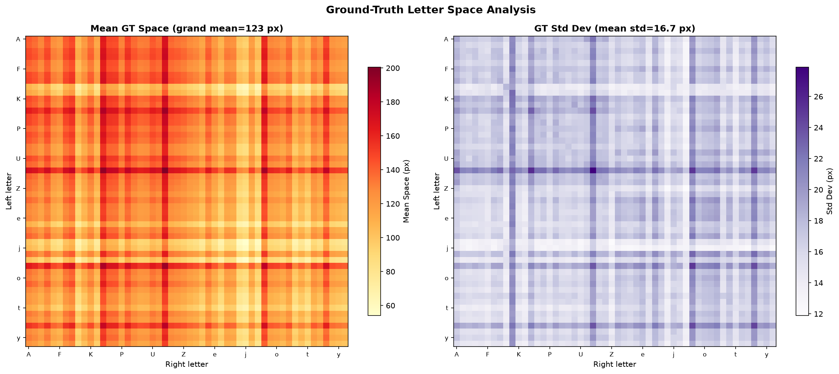
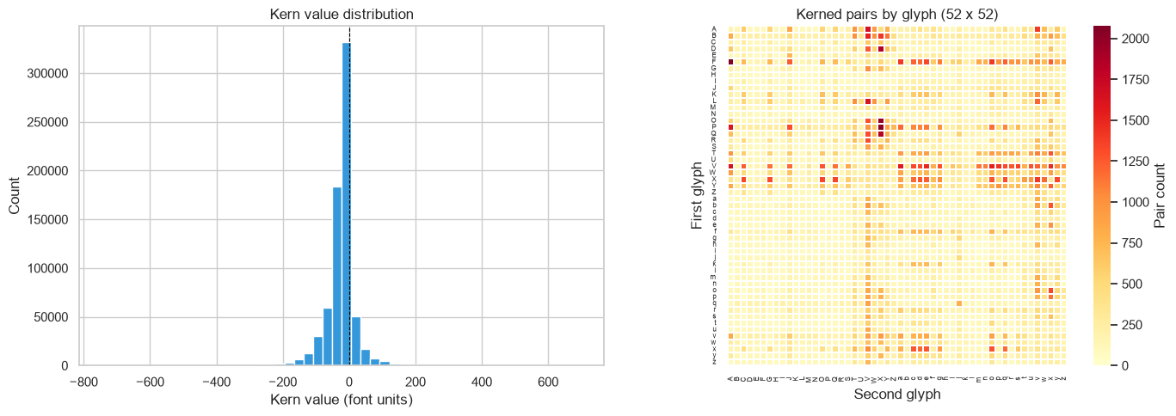
Formula & dataset
- advance(L): width of the left glyph’s advance
- k(L, R) · s: the font’s kerning value
- cx (R) − cx (L): horizontal shift between the two glyph centers

Slide 6
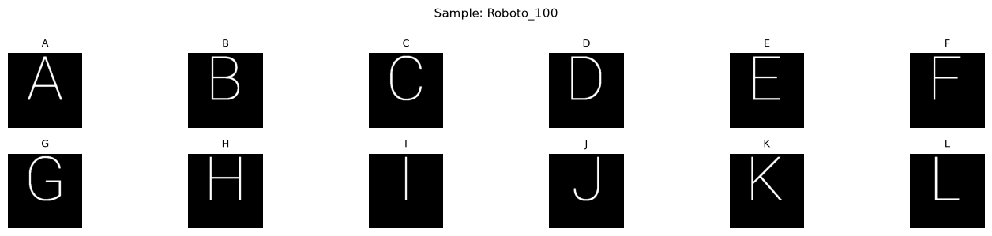
rasterization
- Every font → 52 glyphs, 256 × 256 binary images
- Shared baseline at y =160, one per-font scale
- 7,263 valid fonts · 377,676 glyphs

Slide 7
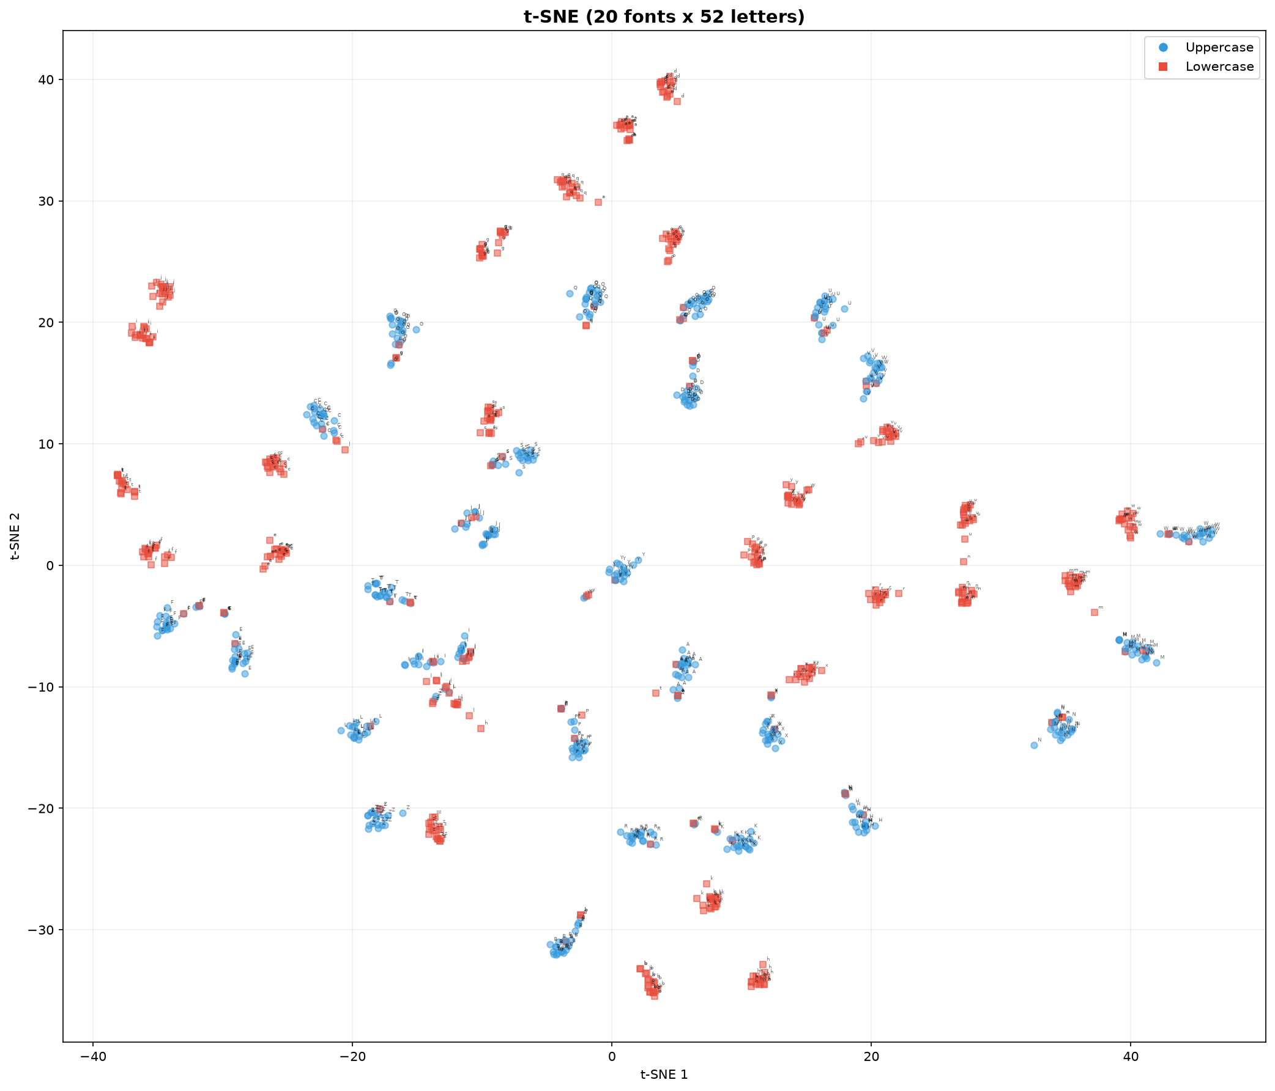
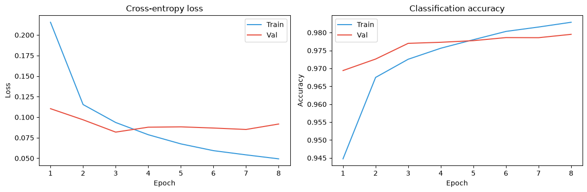
Resnet18
- Trained on 52-way glyph classiﬁcation (test acc 0.971)
- Single channel replicated to the 3 RGB channels, then normalized to [−1, 1]
- 512-d

Slide 8
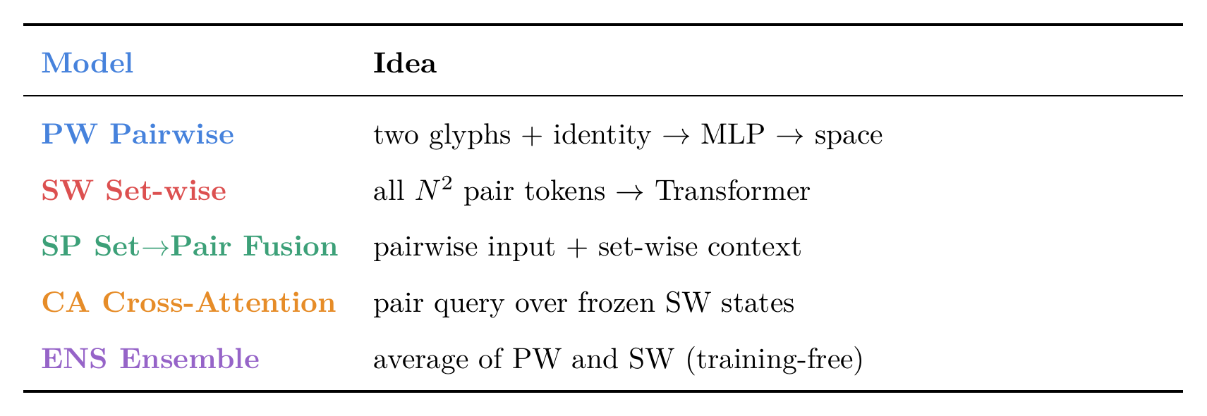
Our models

Slide 9
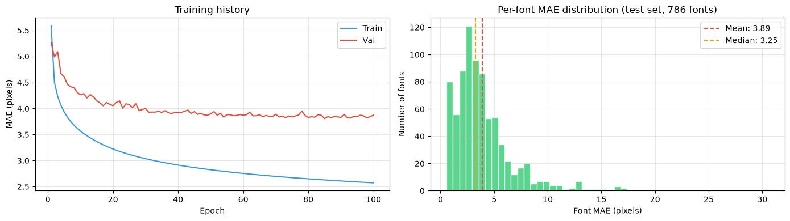
Pairwise
- Input: [f_{L}; f_{R} ; oh_{L}; oh_{R} ] ∈ R¹¹²⁸(2 × 512 features + 2 × 52 one-hot)
- MLP 1128 → 256 → 256 → 1 (ReLU), L1 loss
- 355k parameters

Slide 10
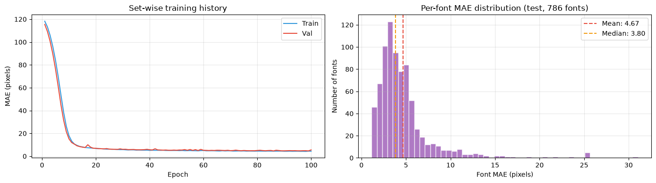
setwise
- One font ⇒ N² = 2,704 tokens [f_{i} ; f_{j} ] (1024-d)
- Project to d=32, then 1-layerTransformer (2 heads)
- 45,6k parameters

Slide 11
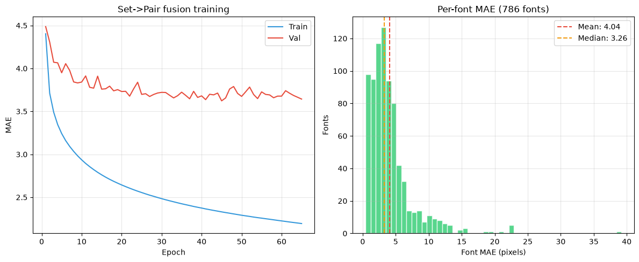
Set→pair fusion
- Adds a global context to the pairwise input
- Context = mean of the frozen SW hidden states (32-d)
- 1160-d input
- 363k parameters

Slide 12
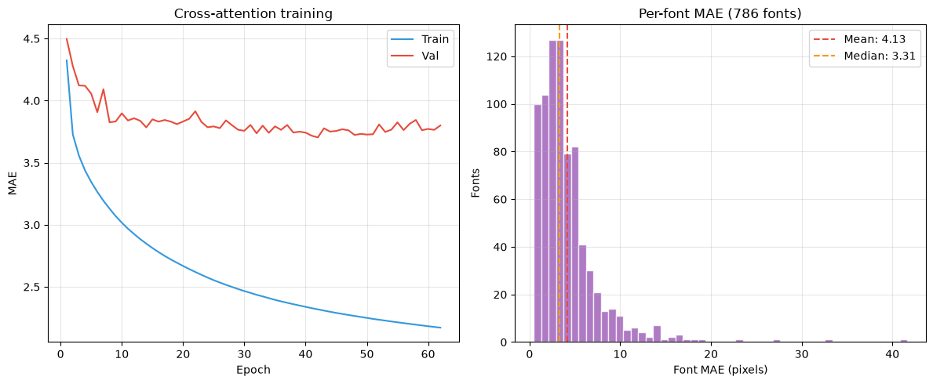
Cross-attention
- Pairwise encoder → query (64-d)
- Query attends over the frozen SW hidden states (K, V)
- Retrieves a pair-speciﬁc context, then MLP head
- 122k parameters

Slide 13

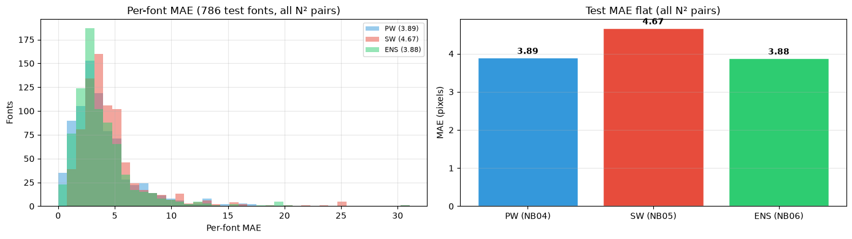
ENSEMBLE
- Average of PW and SW predictions

Slide 14
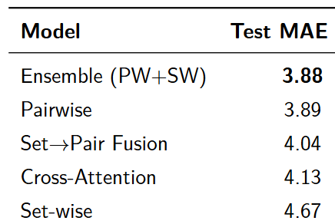
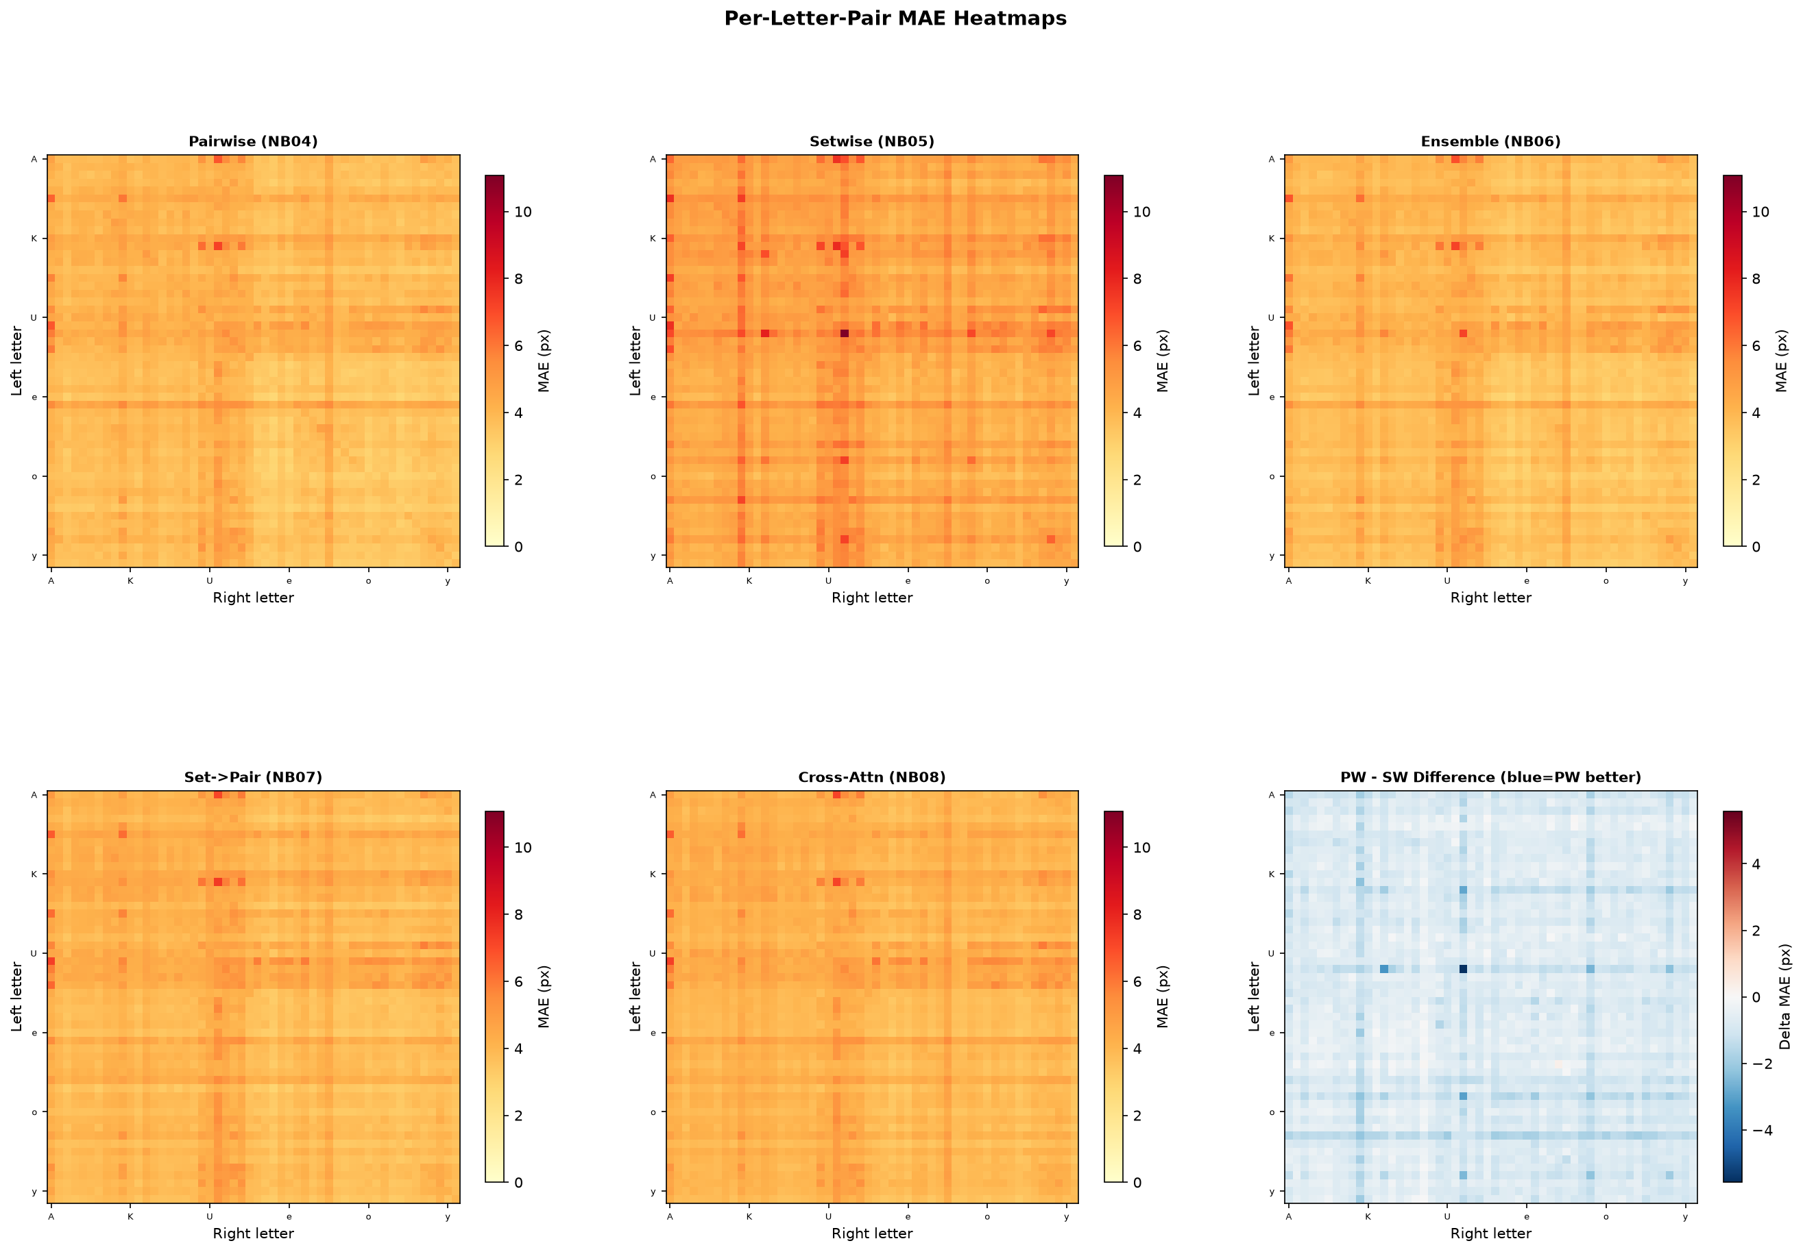
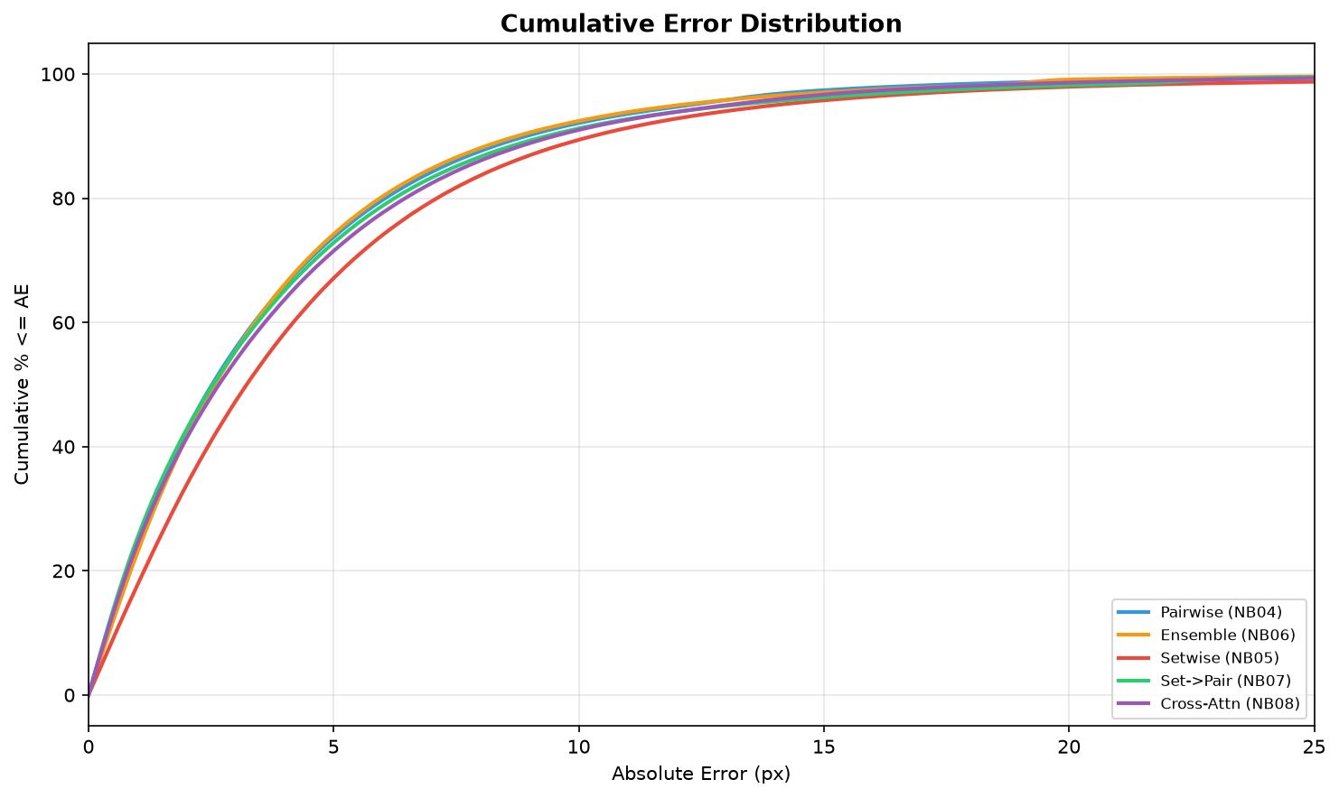
Comparison

Slide 15
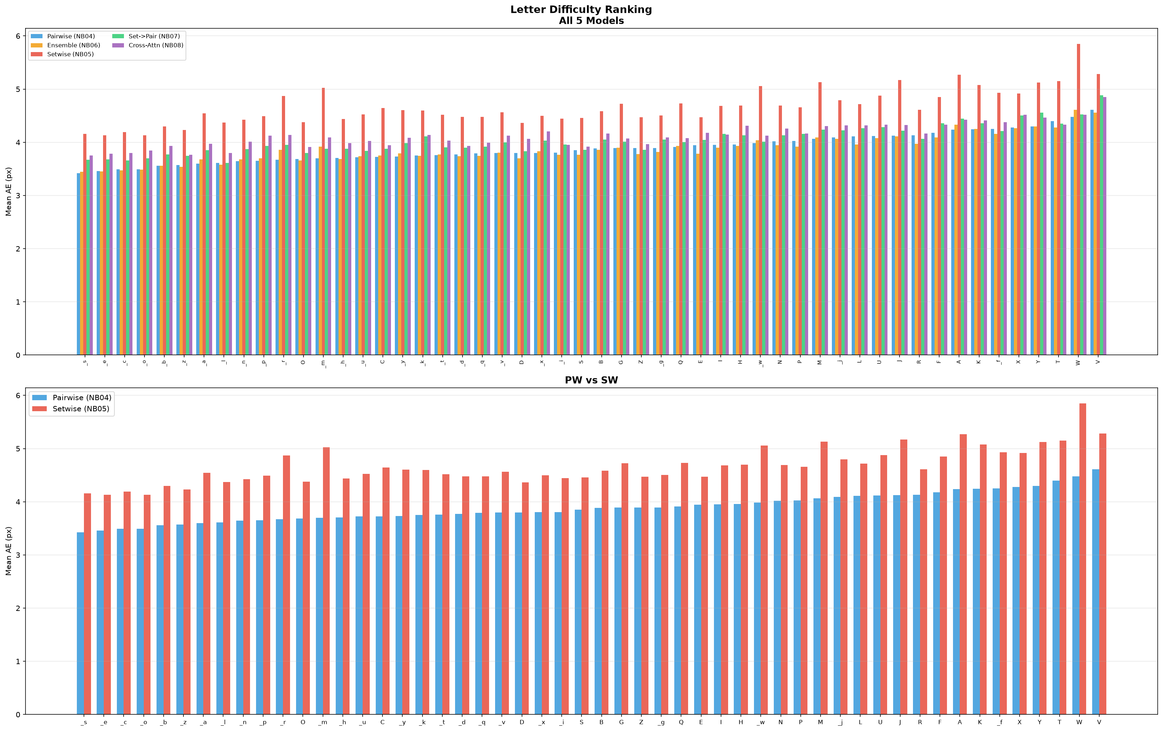
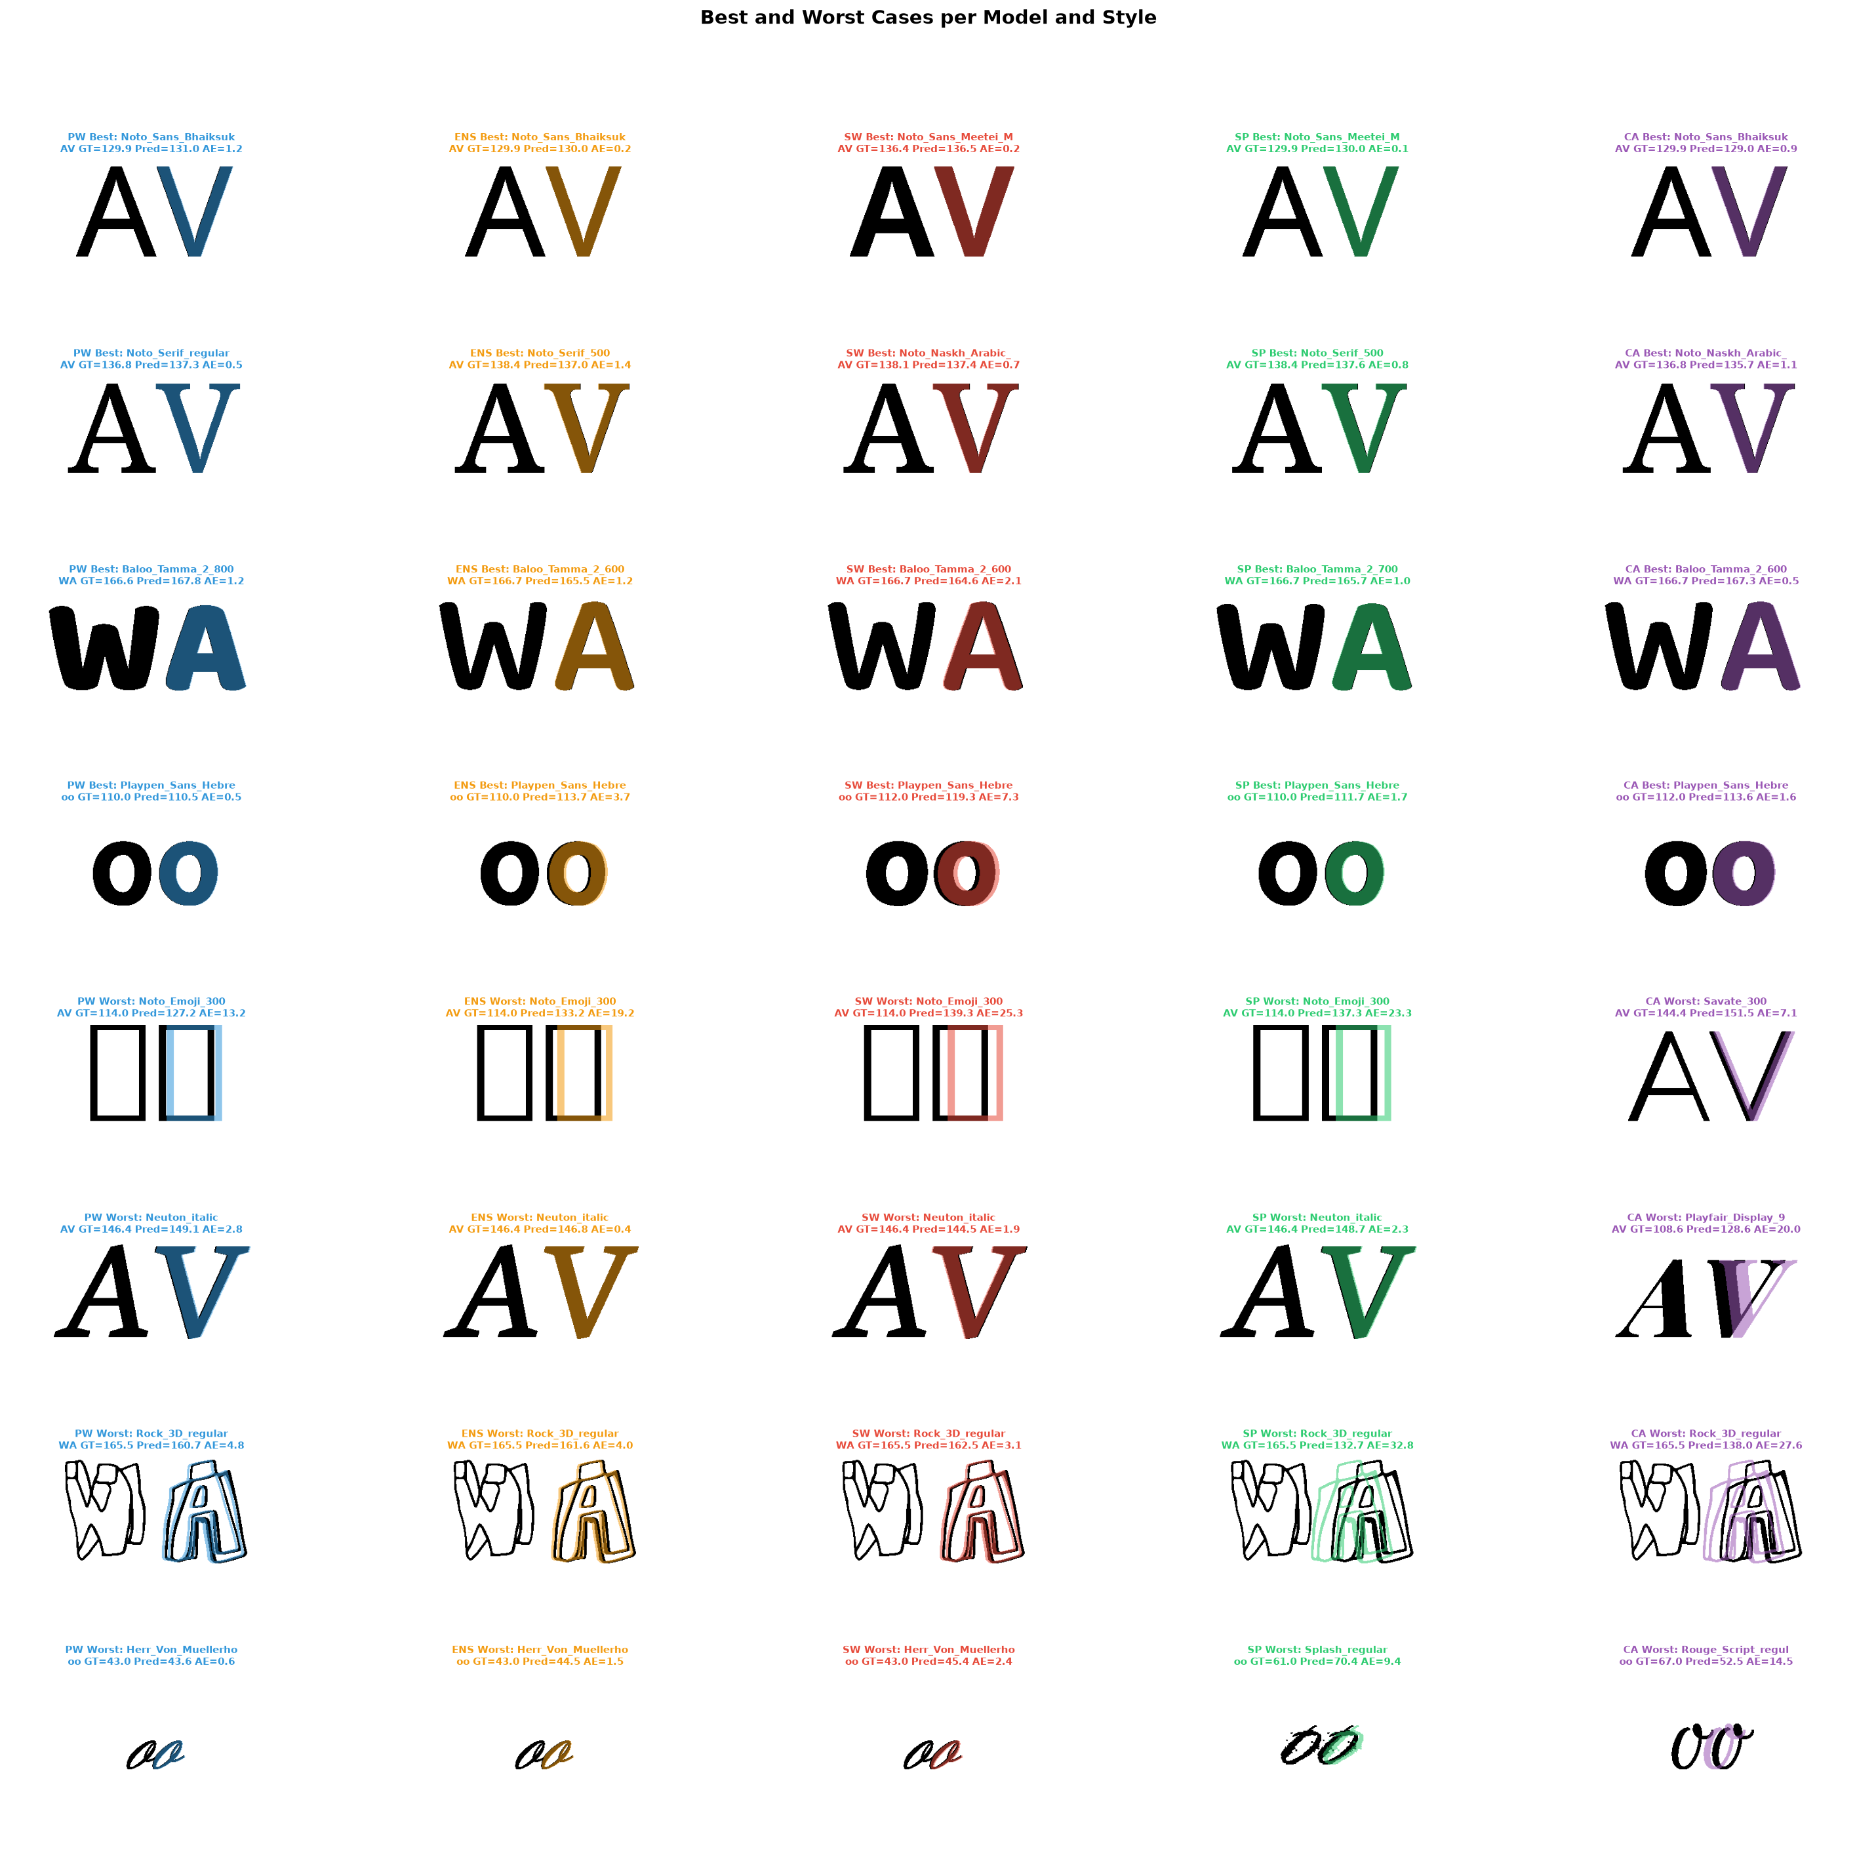
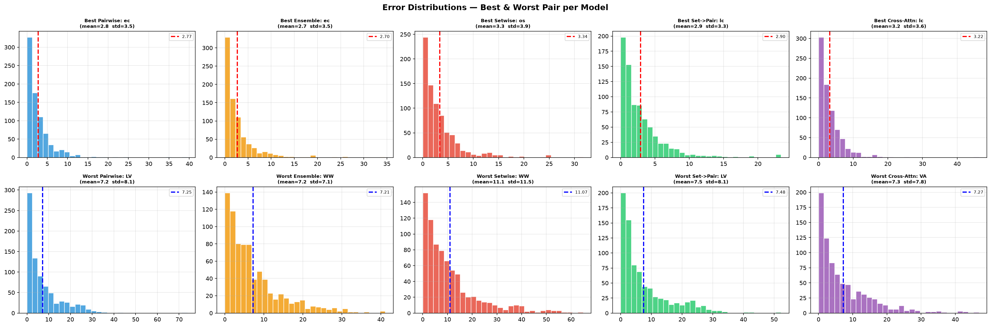

Slide 16
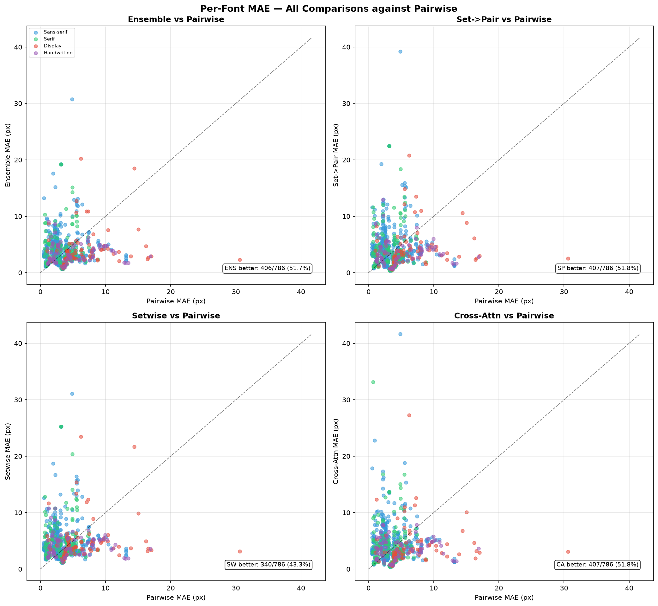
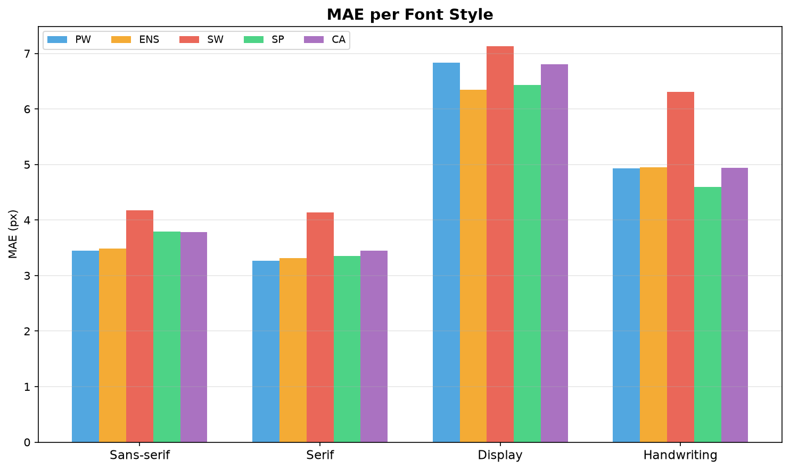

Slide 17
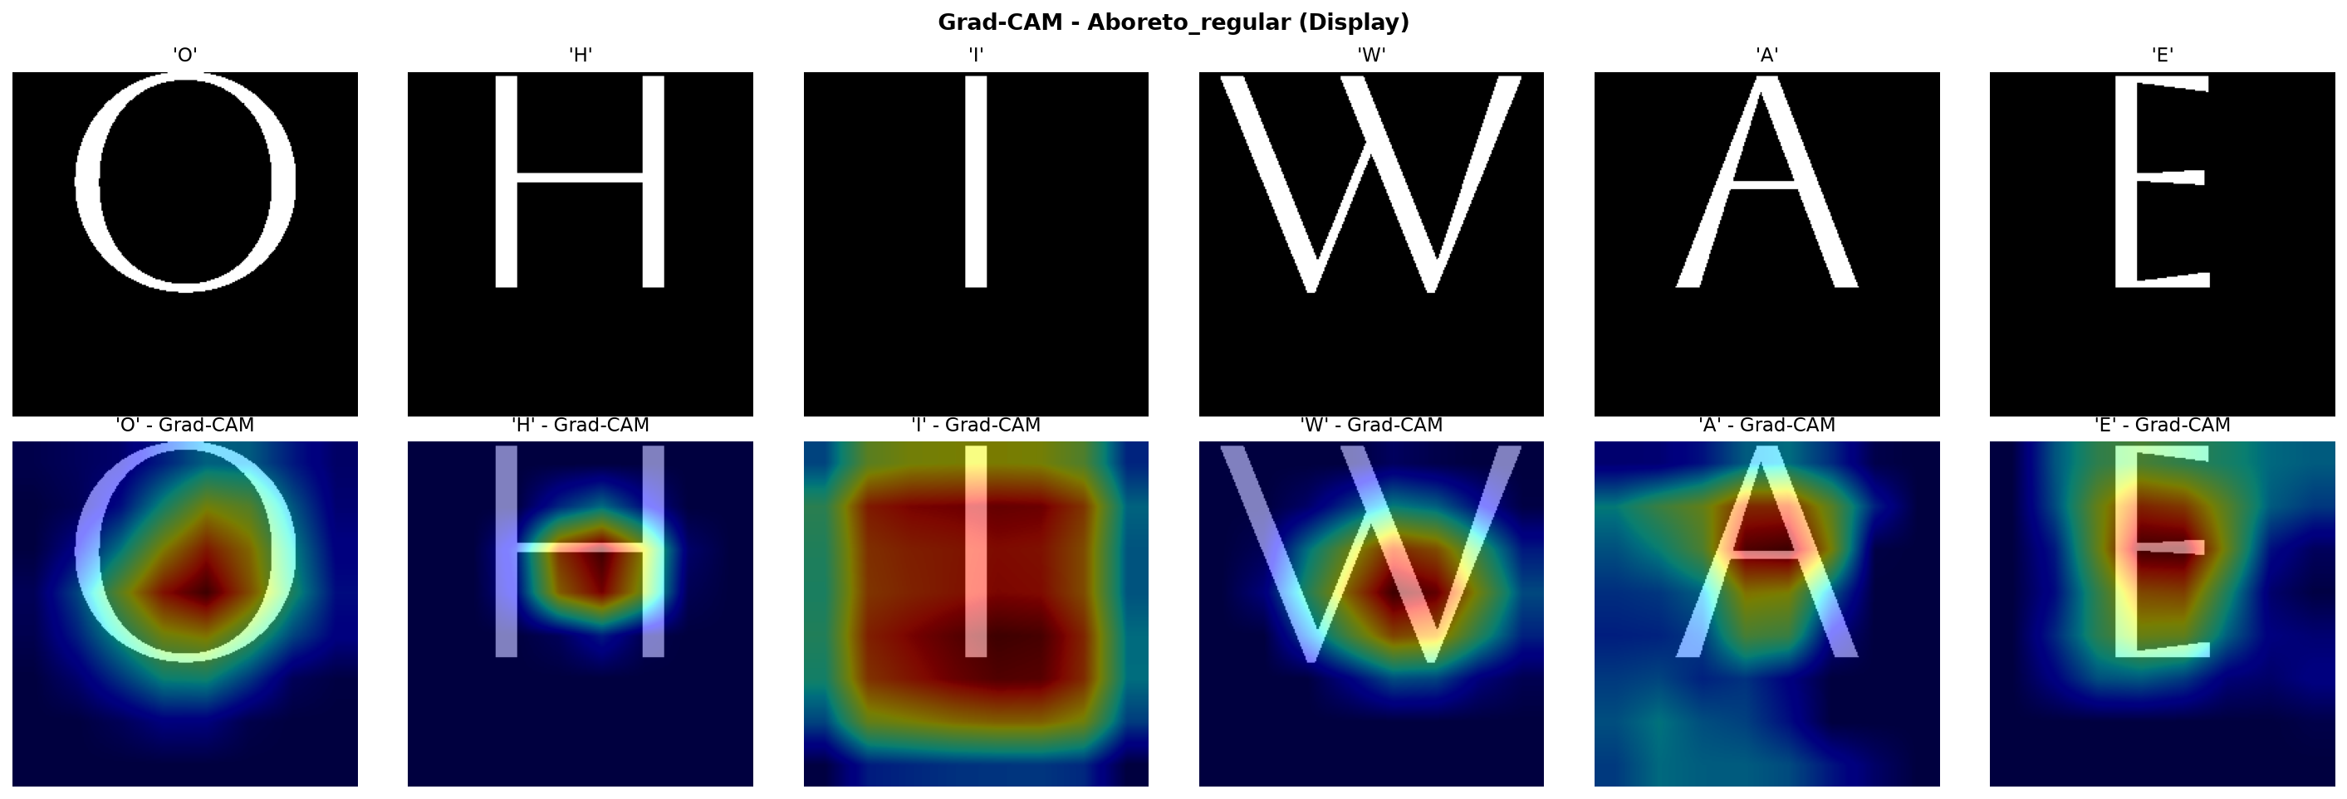
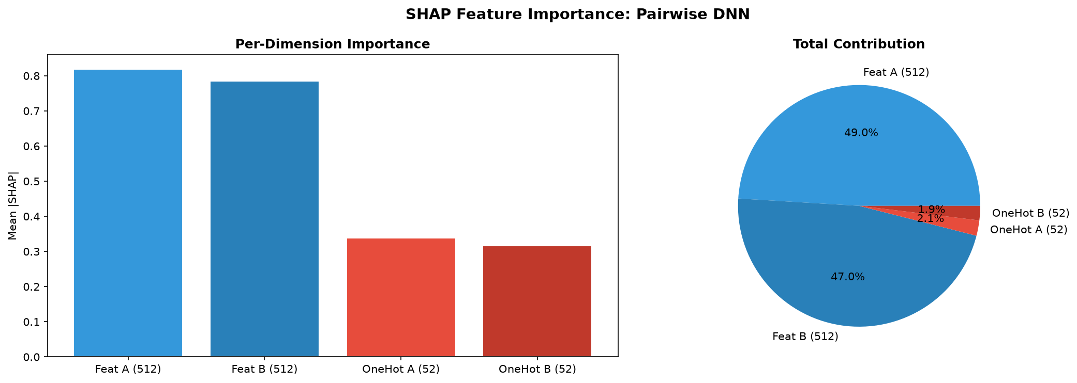
explainability

Slide 18
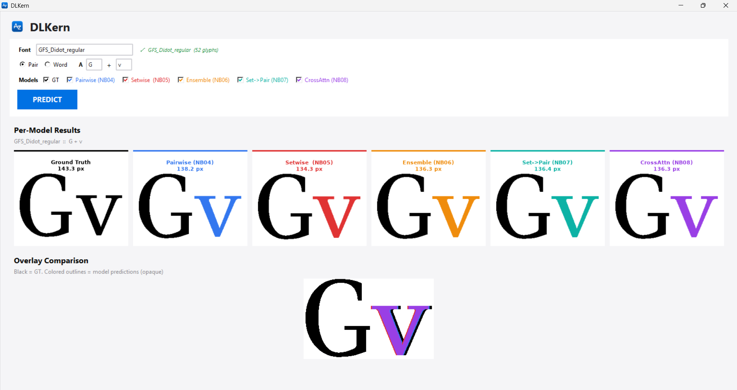
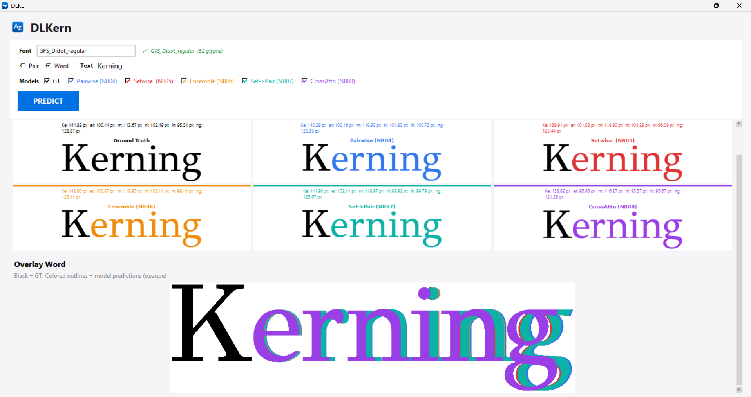
demo

Slide 19
FIN
Angelantonio Fedele Murolo mat. 840167

